Slide 1

AASC Lesson 2.2: Basic Search
Notes:
Find guidance inserted in the note section of each slide.

Slide 2

Overview
2.2.2 Person Search
2.2.3 Vehicle Search
2.2.4 VP Check
2.2.5 Property Search
2.2.1 C-IED Checks

Slide 3
Terminal Learning Objectives
At the end of this lesson participants will be able to demonstrate basic search skills and search awareness in a safe, ethical and legal manner.

Slide 4
2.2.1 CIED Checks (5/25m Drill)

Slide 5
5 and 25m Drill
Introduction – Effect of 5KG Main Charge
5m Lethal
Effect reducing outwards from Seat of Explosion
Beyond 25m Serious injury is unlikely
Notes:
5Kg Blast Main charge
Within 5m of the blast, it will likely be lethal. The further from the seat of the explosion, the less damaging the blast will be, with serious injury unlikely beyond a distance of 25 metres. With this in mind, we maintain a 10m spacing between personnel at all times so that if there is a blast, the number of casualties taken will be minimised.
NOTE: This does not mitigate against the presence of enhancements, so it is advised that PPE is worn during all operations to provide a level of protection against these

Slide 6
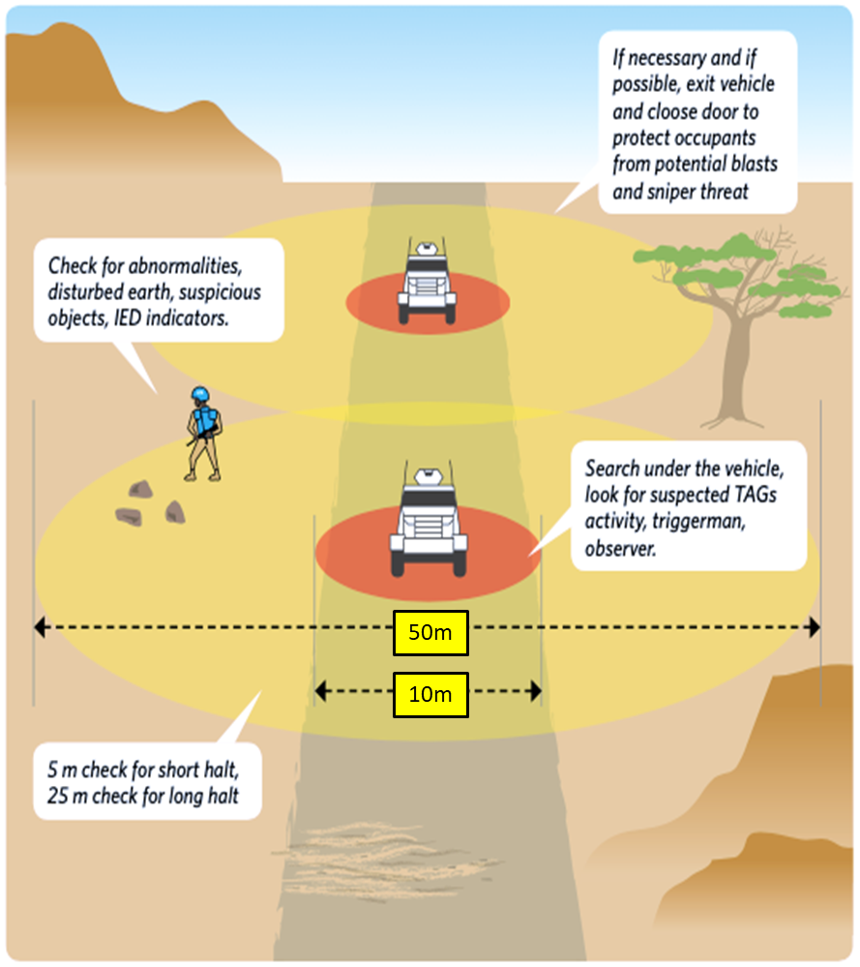
5 and 25m Drill
Introduction
Notes:
Introduction to the 5 and 25 m checks. The purpose of the 5 and 25m checks is to allow troops to identify a safe area (as illustrated in this slide) in which to either go to ground in a static location or for ensuring that any potential ICP or cordon locations are not being targeted by adversary forces.
The 5 and 25 metre individual search is the key Technique, Tactic and Procedure (TTP) taught to military personnel to be carried out on any form of stop or halt. It is probably the single most important action and skill that the soldier applies on operations that is likely to keep him/her alive.
5/25m Checks – Why? Both the explosive science and recent operational experience indicates that an IED functioning less than 5 metres from your position will most likely be lethal. It is therefore a life saving drill to thoroughly search out to a radius of 5 meters on every halt. The same IED functioning between 5 and 25m from your position may still be lethal or could equally inflict life threatening injuries. It is therefore very sensible to extend our search out to 25 metres, although sheer practicality demands that this element of the 5/25m check is less thorough than the 5metre element. Clearly, an IED functioning further than 25 meters away can still be lethal or cause serious injuries, however, on balance, it is IEDs out to 25 metres that result in most serious injuries and fatalities.

Slide 7
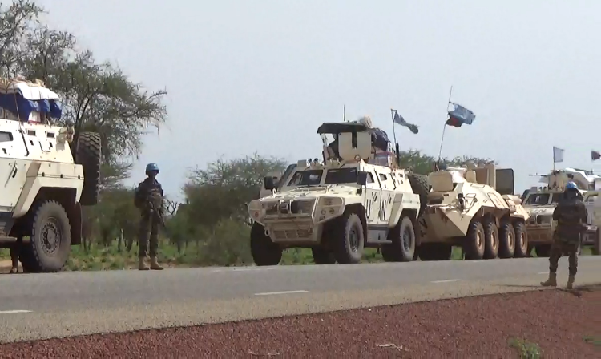
5 and 25m Drill
The 5 and 25m Drill:
A basic drill that can be used by everyone with no specialist equipment or training
Builds on GSA skills
Provides a basic level of assurance any time we stop
Carried out every time we stop
Notes:
Counter IED checks are done through the use of the 5 and 25m drill. This is a tool that can be used by every soldier that requires no specialist equipment or training (although equipment can be used to help). It builds upon the previous skills we learned in Ground Sign Awareness. It provides a level of assurance that there are no IEDs present when a soldier arrives at an unsecured location. This drill should be treated as a standard operating procedure (SOP) and carried out every time we halt on a patrol on convoy regardless of mounted or dismounted.

Slide 8
5 and 25m Drill
The 5 and 25m Drill:
Reduce risk
Promote situational awareness
Deter insurgents.
Notes:
The drill has been designed for 3 main reasons:
reduce risk from IEDs;
promote situational awareness;
demonstrate an alert attitude to discourage insurgents from placing IEDs.

Slide 9
5 and 25m Drill
Overview:
Select location to stop.
Post top cover sentry
Searchers exit the vehicle
5 m search.
25 m search
Search completion.
50m
10m
9
Notes:
Sequence:
Select location to stop. If you are a commander or leader you should ensure your halt is not in VA/VP.
Post top cover sentry. Ensure vehicle top cover is providing 360 degree security, looking for both GSA and in-depth threats.
Searchers exit the vehicle. A searcher or pair of searcher will exit the vehicle, looking for GSA before stepping onto the ground.
5 m search. Once out the vehicle the searcher or search pair will carry out a thorough visual and physical search of the 5m radius around and under the vehicle. The key tool here is GSA but if detectors are available and searchers are trained, they should be used.
25 m search. Once the 5m search is complete, a physical but less thorough search should be carried out to 25m radius. Here we are using GSA to identify any abnormalities and indicators of IEDs. This includes receivers for RC IEDs, Command Wires, remoted battery pack or even basic signs of human/terrorist activity. The 25m check phase is generally carried out only if a long halt is being carried out.
Search completion. Once a search is complete security should be maintained.

Slide 10
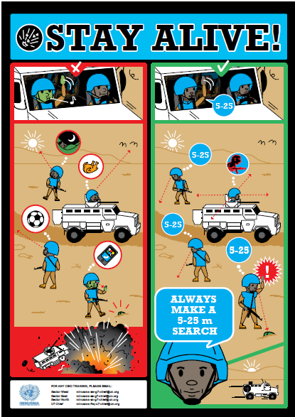
5 and 25m Drill
General points
Look for ground sign
Look up as well as down
Overlap areas
Communication
Spacing
Overwatch
Actions on a find
Notes:
5 & 25m Checks
Procedure – General points
Observe for ground signs and other IED indicators. Revise
Regularity, Flattening, Transfer, Colour Change, Disturbance, Discardables
Remember to observe omnidirectional; up, down and all around.
Overlap areas of responsibility – view the ground from different angles
Communicate and tell each other what you see – two pairs of eyes are better than one
Maintain 10m spacing
Maintain over-watch
If ground sign or suspicious items are identified conduct a 5Cs operation. The confirmation part of the 5Cs may involve requesting assistance from the S&D team however personnel should move to the correct distance prior to this activity.

Slide 11
5 and 25m Drill
Patrol Halts
Short halts (up to 5 minutes) a 5m check is completed.
If remaining static for longer a 25m check is completed.
Notes:
Patrol Halts:
Whenever a patrol or convoy stops, checks must be conducted to provide assurance that the immediate area is safe from IEDs. Short halts of up to 5 minutes require a 5m check to be completed. If staying for longer than 5 minutes, troops will complete the 5m check and move straight into the 25m checks.

Slide 12
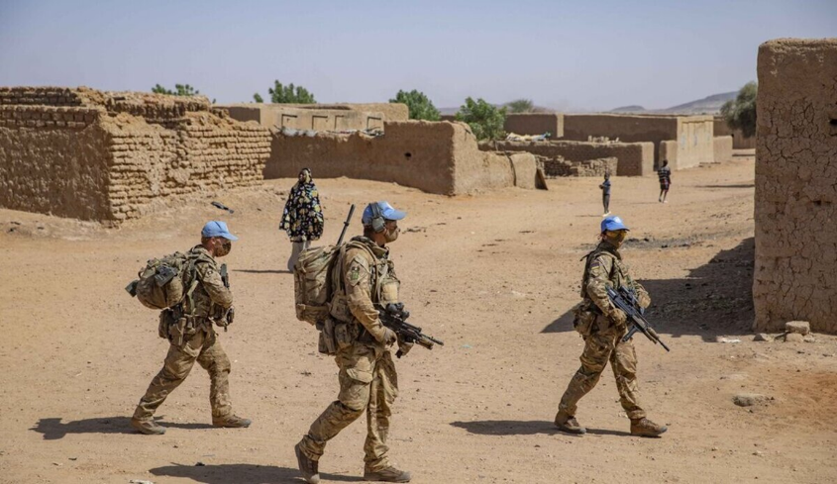
5 and 25m Drill
Dismounted Drill
The drill is largely the same
Every person conducts own 5 and 25m check
Notes:
Dismounted Drill:
This lesson will focus on the more complex mounted drill. However, this drill is also carried out when conducting dismounted patrols. The process is largely the same. Unlike with the mounted drill that uses designated searchers, in the dismounted drill, everyone carries out his or her own 5 and 25m check.

Slide 13
5 and 25m Drill
Adapted procedures dependant on the following factors:
Number and type of vehicles in the patrol/convoy.
Number of troops available.
The ground.
The threat.
Principles remain the same.
Notes:
Patrol Halts:
The exact procedure can be adapted dependant on a number of factors:
Number and type of vehicles in the patrol/convoy.
Number of troops available.
The ground.
The threat.
The basic principles remain the same.

Slide 14
2.5.2 Demonstration and Practice

Slide 15
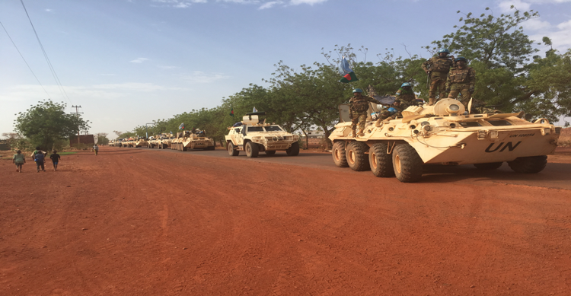
5 & 25m Checks
Procedure in detail:
A single vehicle
Driver
Commander
Gunner
4 personnel
Can be adapted
Notes:
5 & 25m Checks Procedure in Detail. We will now go through each of the phases of the mounted 5/25m drill in detail. For the purpose of this example we will follow the procedure based upon:
A single vehicle
Driver
Commander
Gunner
4 troops
However, this can be easily adapted based on the number of personnel available.

Slide 16
5 and 25m Drill
Stage One – Select a stop Location
Driver and Commander observe route to the intended halt location.
When suitable place identified the Commander orders the halt.
Gunner completes a 360 degree observation of the vehicle and surrounding area.
Nothing seen, move to stage 2.
Threat identified (confirmed), 5Cs operation.
Notes:
Stage One – Select a stop location:
Once it is identified that there is a requirement to stop, a suitable location will be identified, making sure it is in an unpredictable location. Upon halting, the gunner will carry out a 360-degree scan of the area checking for anything that may pose a risk.
If nothing is seen, commander will be informed, and the team will move to stage 2.
If something is identified, 5Cs will take place; this will be taught later.

Slide 17
Notes:
Stage 1 Select a stop location:
The gunner completes a 360-degree observation of the vehicle. During the observation he needs to look for:
Ground Sign.
IED indicators.
IED component parts.
Any suspicious movement around the area.

Slide 18
Any Questions on Stage 1?

Slide 19
5 and 25m Drill
Stage two - 5M check
Commander orders the conduct of the 5m check.
One person exits the vehicle after visually checking the ground, closes the door and moves 2m from the vehicle.
Searches under and 360 degrees around the vehicle to a distance of 5m from the vehicle.
The Gunner remains in over-watch position.
Nothing found, return to vehicle or conduct stage 3 (if remaining for over 5 mins).
Threat identified (confirmed), 5Cs operation.
Notes:
Conduct Stage 2 – 5m Check:
Person will look at the ground before they disembark to ensure it is safe to leave, and close the door
Immediately look beneath the vehicle to check for possible threats
Moving around the entirety of vehicle, looking out to 5 metres, and also beneath the vehicle intermittently.
The 5-metre check will be completed once the person has reached the point at which they exited the vehicle and gone beyond this to ensure overlap.
The gunner will remain in overwatch
If nothing is seen, commander will be informed.
If a short stay, the person will get back into the vehicle.
If something is identified, 5Cs will take place.

Slide 20
1 person prepares to exit the vehicle.
Visually searches the ground before stepping down.
Moves 2m from the vehicle.
Gunner maintains overwatch.
Notes:
5m Checks:
Soldier conducts sweep around and under the rear of the vehicle as shown in the arcs. Gunner provides overwatch.

Slide 21
Sweep continues 360° around the vehicle in sweeping visual arcs. Gunner provides over-watch throughout.
Notes:
Stage 2 – 5 metre check
Sweep continues 360° around the vehicle in sweeping visual arcs. Gunner provides over-watch throughout.

Slide 22
Any Questions on Stage 2?

Slide 23
5 and 25m Drill
Stage Three – 25m Check
On completion of 5 metre check:
First soldier dismounts and moves 20m to the 6 o’clock position.
Second soldier dismounts and moves 20m to the 12 o’clock position.
After dismounting the vehicles should be shut.
Notes:
Phase 3: 25 metre Check.
If the stay will be longer than 5 minutes, the team will move into stage three; the 25-metre check.
The person who completed the 5-metre check will move 20 metres to the 6 o’clock position, searching as they move
A second searcher will be instructed to move 20 metres to the 12 o’clock position, searching as they move. They must close the door of the vehicle as they exit.

Slide 24

20m
20m
Notes:
Phase 3: 25 Metre Check:
Once the 5m check is completed:
First man moves 20m to the 6 o’clock position.
Second man dismounts and moves 20m to the 12 o’clock position.

Slide 25
5 and 25m Drill
Stage three – 25m Check
Once the First and Second man moves 20m to the 6 o’clock and 12 o’clock position the:
Third man dismounts and moves 10m to the 6 o’clock position.
Fourth man Dismounts and moves 10m to the 12 o’clock position.
Notes:
Stage 3 – 25m Check;
Once the first two are in position, the next troops will be instructed to move to their relevant positions:
One will move 10 metres to the 6 o’clock position, searching as they move.
The final person will move 10 metres to the 12 o’clock position, searching as they move.

Slide 26
10m
10m
20m
20m
Notes:
Stage 3 – 25 metre check
This slide explains the position of troops before they start the 25-metre search.

Slide 27
5 and 25m Drill
The four-man team completes a 360° visual search moving in a clockwise or counterclockwise direction.
Areas of responsibility are:
5 to 15m.
15 to 25m.
A minimum of 10m spacing between troops is maintained at all times.
Notes:
Stage 3 – 25m Check:
The four men then complete a 360° visual search moving in a clockwise or counter-clockwise direction, under direction of the commander.
Areas of responsibility are:
5 to 15m.
15 to 25m.
A minimum of 10m between troops is maintained.
Throughout the gunner will maintain overwatch and provide protection, allowing the rest of the team to concentrate
on their checks.
If nothing is seen, commander will be informed.
If something is identified, 5Cs will take place.

Slide 28
Notes:
Stage 3 – 25m Check:
The four man then complete a 360° visual search moving in a clockwise or counter clockwise direction.
Areas of responsibility are:
5 to 15m.
15 to 25m.
A minimum of 10m between troops is maintained.

Slide 29
Any Questions on Stage 3?
Notes:
Any Questions on Stage 3?

Slide 30
General Points
Observe for ground sign and other IED indicators.
Remember to check above ground – trees etc.
Overlap areas of responsibility – view the ground from different angles.
Communicate to each other what you see – two pairs of eyes are better than one.
Maintain 10m spacing at all times
Overwatch must be maintained at all times
Notes:
General points:
Communication is key. Partners should always be talking to make sure they do not fall out of alignment as this can lead to someone cutting across and not checking the area sufficiently.
Observe for ground sign and other IED indicators. If something suspicious is seen it must be investigated before continuing
Remember to check above ground – trees etc.
Overlap areas of responsibility – view the ground from different angles
Communicate to each other what you see – two pairs of eyes are better than one
Maintain 10m spacing at all times
Overwatch must be maintained at all times

Slide 31
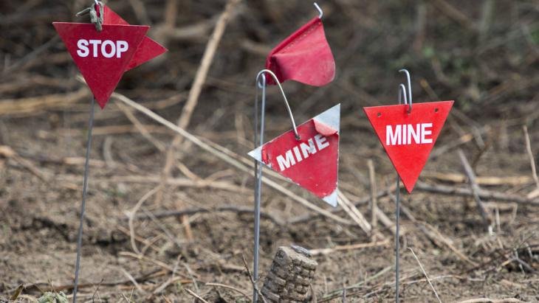

Questions?

Slide 32
2.2.2 Person Search

Slide 33
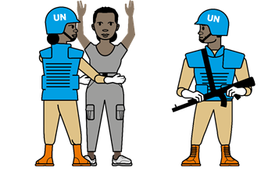
Person Search
Search of a person to detect components, weapons, ammunition, or any other exploitable intelligence that a person may attempt to conceal.
Notes:
Definition. Search of a person to detect components, weapons, ammunition, or any other exploitable intelligence that a person may attempt to conceal. The correct person search procedures are taught during the EHAT course.

Slide 34
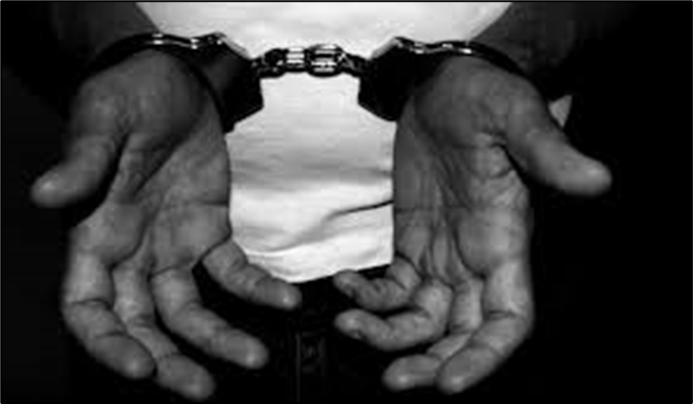
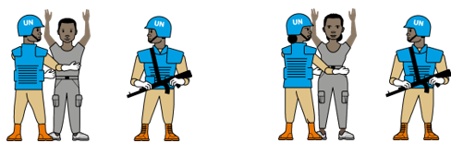
Person Search
Ethical and Legal Considerations
Legal considerations
Mission specific permissions
International Humanitarian Law
Restraints
Avoiding allegations of harassment and violence
Sex
Searching of children
Safety of searchers
2 searchers (protection and searcher)
Not crossing the line of fire
Always treat the person being search with respect!
Notes:
Certain considerations must taken into account when those under your command conduct person searches. First and foremost as commander we must ensure that those conducting persons searches are following the mission specific rules. Regardless of mission, or level of risk, there should be no contradiction to international humanitarian law. The use of restraints while conducting a search must be based on the situation and according to the local directives.
Secondly, searches must be carried out in the view of the public (unless for cultural reasons) and must be conducted with professionalism and respect for the subject. Remember that the vast majority of those who are searched are innocent civilians. Any interaction with them must be a positive engagement. This serves both to improve the image of UN troops but also avoids unnecessary allegations of harassment and violence.
Linked to avoiding harassment, the sex of searchers and subjects must be considered. Wherever possible and subject to the tactical situation, men should search men, and women should search women. Additionally, where children need to be searched, this should be carried out by a female searcher who is observed and supervised by a second person.
Finally the safety of UN troops conducting the search must be taken into consideration. Amongst other procedures, any person search should be conducted by a minimum of two; one person to carry out the search, the other to provide protection. Whilst conducting the search, the searcher should never stand between the person providing the protection and the person being searched.

Slide 35
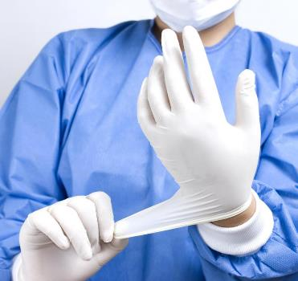
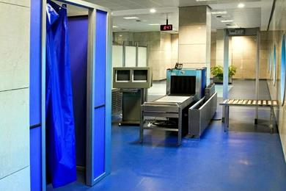
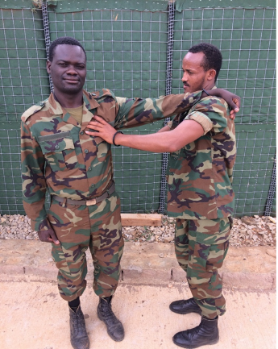
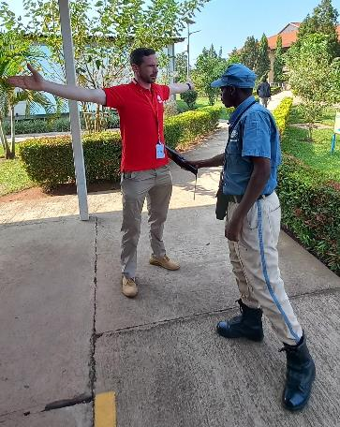
Person Search
Intimate
Levels of Person Search
Under no circumstances should un-trained, un-qualified or un-authorized persons undertake Strip or Intimate searches!
Strip
Covered in EHAT
Detailed
Initial/Quick
Increasing level of:
Threat
Time
Training
Rules/legal
Notes:
There are four levels of Person Search. Initial, Detailed, Strip and Intimate. Only Initial and Detailed are covered by the EHAT course. An initial search is a very quick search which is used to screen or deter hostile actors from entering a location or carrying components. It is the kind of search you might expect when entering a shopping centre. For the purpose of speed it usually entails the use of hand held or fixed scanners. A detailed search is used where suspicion is raised, following an initial search. It should take no longer than 2 minutes. Under no circumstances should un-trained, un-qualified or legally un-authorized persons to undertake Strip or Intimate searches. If after conducting an initial or detail search, there is remains suspicion of a person, the person should be handed over to the relevant policing authority. This is be subject to mission rules and policy.

Slide 36
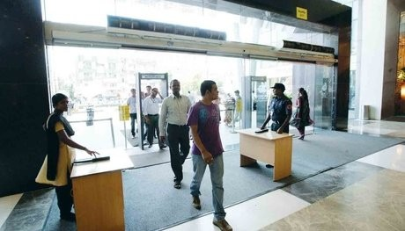
Person Search
Initial/Quick Search
Generally carried out in public view
Usually for searching large numbers of people
Done Quickly
Often uses hand held metal detector or scanners
Commonly conducted by local police/military or security companies
Notes:
An initial search also called a quick search which is used to screen or deter hostile actors from entering a location or carrying components. Generally conducted in view of the public and when dealing with large number. To this end it must be done quickly. To allow this, it often uses scanners or hand held metal detectors. Generally this is done by local security services or contracted security companies. As a peace keeper you may be tasked with providing security for public venues or even you own operating bases. In this case you should know how to uses a hand held detector and how to conduct this search.

Slide 37
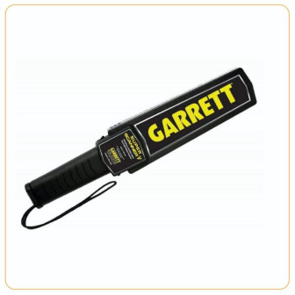
Person Search
Initial/Quick Search
Check the person is not fitted with a medical implant.
Do not touch the person’s body.
Do not contour the body.
Ask the person to remove outer clothing only.
Where possible, always ask the person to remove any detected metal objects.
Where metal is detected, a hands-on Search by a Searcher of the same sex.
Notes:
Metal detectors are extremely useful tools that can be used to assist in person Search. A metal detector can detect materials containing ferrous metals including lethal weapons, arms and ammunition. In addition, the detector can be used by a male to Search a female, although this procedure should only be used when no female Searchers
are available. When performing a person Search using a detector, the appropriate safety procedures for the equipment must be followed.
In general:
a. Check the person is not fitted with a medical implant.
b. Do not touch the person’s body.
c. Do not contour the body.
d. Ask the person to remove outer clothing only.
e. Where possible, always ask the person to remove any detected metal objects.
f. Where metal is detected, and the person cannot explain its presence to the
satisfaction of the Searcher, it is necessary to perform a hands-on Search by a
Searcher of the same sex.

Slide 38
Person Search
Initial/Quick Search
Investigate likely areas of concealment:
Small of the back
Under arms
Crotch/groin area

Slide 39
Person Search
Initial/Quick Search
Response:
If satisfied with the initial search, no further investigation.
If suspicion is aroused, the next step is a detailed search.

Slide 40

Person Search
Detailed Search
The detailed search is generally carried out away from the view of general public
Done thoroughly and systematically
Notes:
If a detailed search is required, we will generally move the person away from the general view of the public. This is so the initial search area can continue to function normally, to protect the general public if there is an explosive incident and to preserve the dignity of the person being searched. This search is done in a systematic way. It is not a random process. This ensures it is done thoroughly.

Slide 41
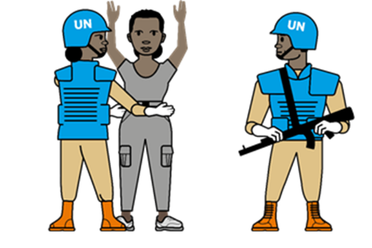
Person Search
Detailed Search – general guidance
Work in pairs – 1 searcher, 1 cover.
Establish the subject’s ID and ownership of any baggage
A second searcher if available, can be used to search baggage or removed clothing
Ask subject to empty all pockets
Gloves must be worn by the searcher
The Searcher should not stand directly in front of a subject to avoid being kicked, struck with a knee or head-butted
Notes:
Detailed search should be carried out in pairs with a searcher and a cover.
The subjects identify should be established.
All subjects must be treated with respect, the same applies to their belongings – All property, baggage or removed clothing.
The subject is to be invited to empty their pockets – again this property is to be treated with respect. Where possible, if a suitable table or tray is not available, lay out some cloth / plastic / sandbag to place items on. Items should remain separated from the subject but be within the subjects line of sight.
It is important that the searcher asks the subject if there is any sharp / dangerous items on their person, searcher to remain mindful of possible dangerous items throughout the search.
Gloves should be worn by the searcher, although forensic evidence is not currently being utilized in country, this may always change. Gloves also offer a layer of protection to the searcher.
The searcher should not position themselves such that they can be struck by the person being searched.

Slide 42
Person Search
Detailed Search – general guidance
The searcher should not cross the line of fire
Subject should stand with legs slightly apart and arms naturally at the side
Search efficiently and systematically from head to foot, covering all parts of the body
Don’t pat. Use a stroking/squeezing movement
Notes:
The searcher should not cross the line of fire. Ie the searcher should never be directly between the cover or protection and the person being searched. This is in case the cover person needs to use lethal force and the searcher being caught in the cross fire.
Subject should stand with legs slightly apart and arms naturally at the side.
Search efficiently and systematically from head to foot, covering all parts of the body
Don’t pat. Use a stroking/squeezing movement.

Slide 43
Person Search
Detailed Search
The person should be searched systematically by dividing the body up into 5 areas
Head
Left Side Torso
Right Side Torso
Left
Leg
Right
Leg
Notes:
The body is quartered plus the head – giving us our 5 distinct areas.
As with all search we also have to ensure every part of the body is searched by undertaking overlap between all neighbouring sections.

Slide 44
Person Search
Detailed Search
During the Search as well as searching the body, clothes must also be searched
Special attention should be paid to:
Pockets
Waistbands
Cuffs
Hems
Belts
Lapels
Padding
Any thickened area of clothing
Notes:
During the Search as well as searching the body, clothes must also be searched
Special attention should be paid to:
Pockets
Waistbands
Cuffs
Hems
Belts
Lapels
Padding
Any thickened area of clothing

Slide 45
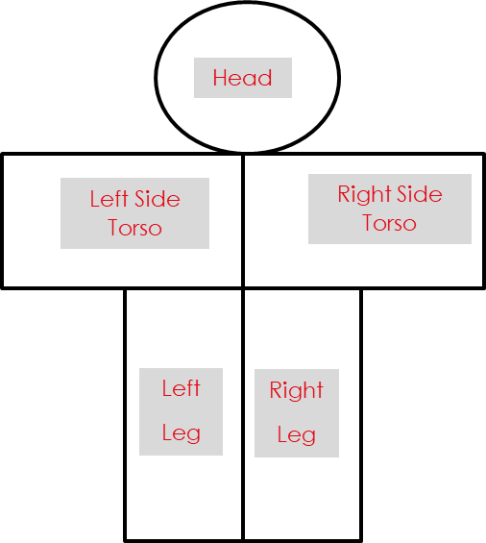
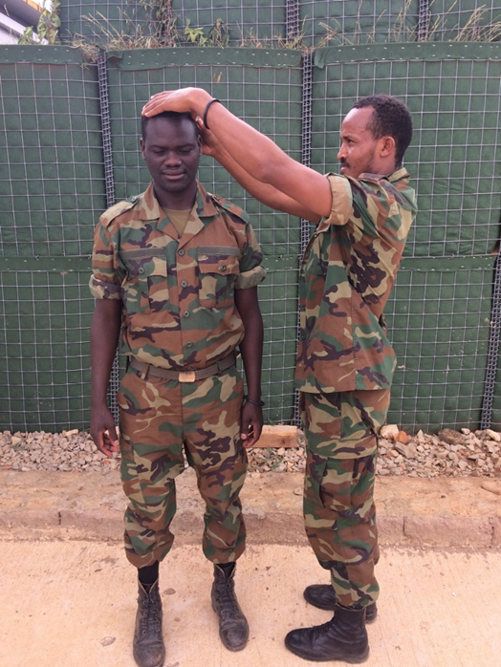
Person Search
Detailed Search – The Head
Notes:
The search starts at the head (the first of our 5 sections).
If necessary the searcher would ask the subject to remove any head dress (the removed head dress must also be searched – following the same procedure as any outer garments). If head dress is worn for religious reasons, the subject may be permitted to be searched out of the public eye.
Searcher to move on to searching the head of the subject. I f the subject has thick or tied up hair, the searcher must use fingers to search the hair thoroughly.
The searcher must then look in subjects ears, nose and mouth (asking subject to open mouth).
Once the whole head has been searched the searcher can move to the collar, searching as demonstrated earlier for thickened clothing.
As soon as the searcher is happy he can move onto the next section of the body.

Slide 46
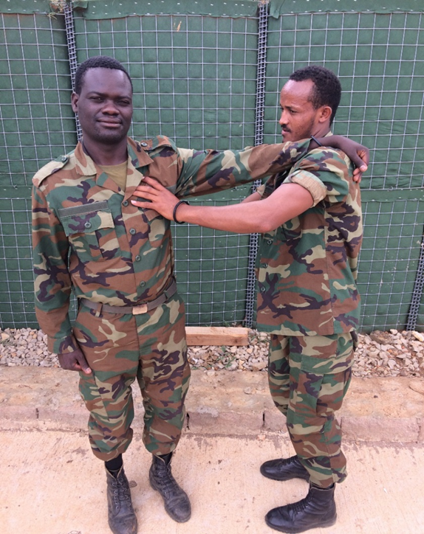
Person Search
Detailed Search – Left Torso
Notes:
The second section, searcher next logically moves down the body to the left torso (to include the left arm).
The searcher uses the squeezing / stroking motion to search the whole of the left torso including left arm.
REMEMBER overlap with all neighbouring sections:
Overlap with – Right Side Torso.
Overlap with – Collar Section.
Overlap with – Left leg section (belt area).
Searcher to cover whole section incorporating the thorough check of the belt area (as demonstrated earlier for thickened material areas).

Slide 47
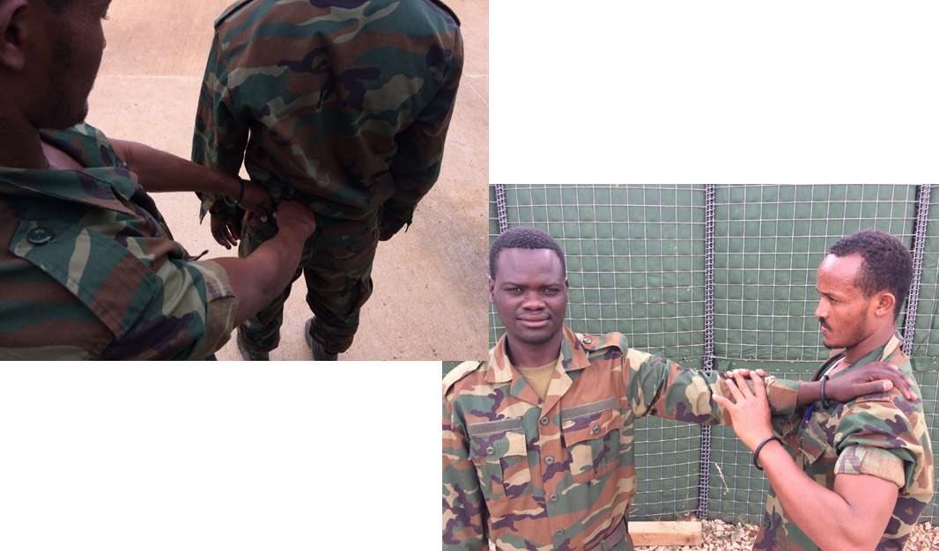
Person Search
Detailed Search – Left Torso
Notes:
The searcher, must then search the arm.
Ensuring to go right into the armpit (which provides a good place to hide items).
Moving down the arm using the same squeezing / stroking method. Making sure that the searchers hands meet and therefore cover the entire arm.
It is important to search down to and include the hand.
As per all clothing checks, ensure the cuff is searched as demonstrated.
If the subject is wearing a watch or jewellery, make sure to check behind these.

Slide 48
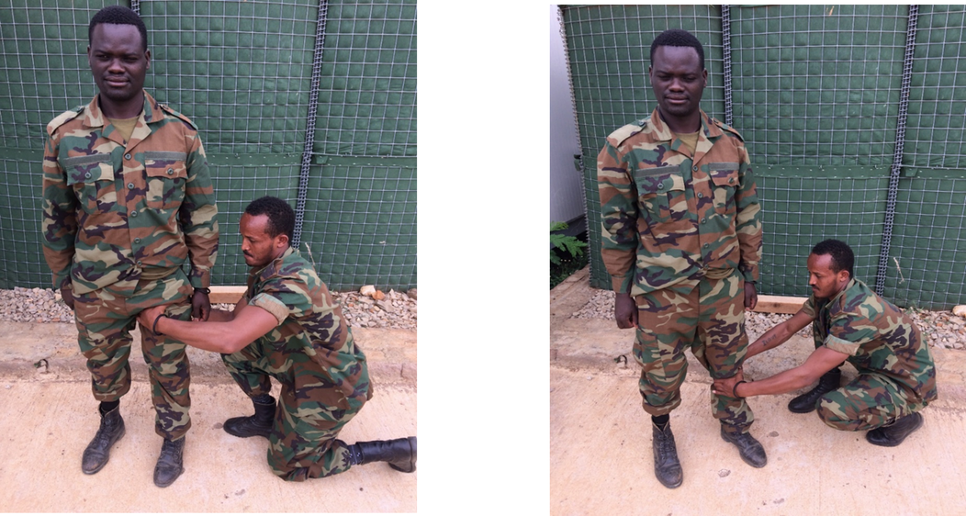
Person Search
Detailed Search – Left Leg
Notes:
The searcher moves down the left leg of the subject.
Searcher to ensure to search right into the groin area (similar to the armpit). SEARCHER MUST WARN SUBJECT WHEN ABOUT TO DO THIS.
Squeezing motion used to cover entire leg. Ensure that area covered by hands overlaps, all the way down the leg.
Searcher to make sure to pay attention to any pockets.

Slide 49
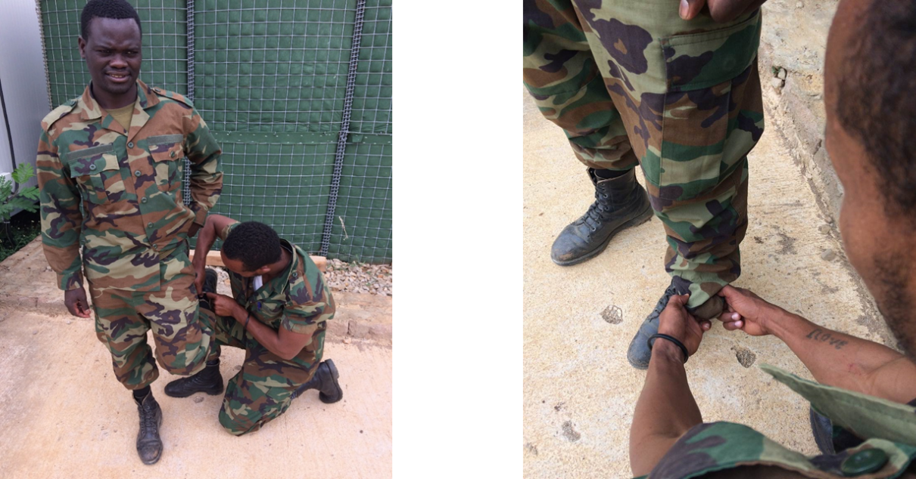
Person Search
Detailed Search – Left Leg
Notes:
On reaching the bottom of the leg, searcher is to check hem of trousers (thickened cloth check).
Searcher can ask subject to remove their shoe.
To check the underside of the foot / shoe, searcher can kneel down and rest subjects raised foot on their own knee.

Slide 50
Person Search
Detailed Search
Same process for Right Torso and Right Leg
Notes:
The same process should be followed for the right hand side of the body.

Slide 51
Person Search
Detailed Search
ACTIONS ON A FIND
Non Life Threatening Find:
Item removed
Search Completed
Subject Arrested
Life Threatening Find:
5Cs
Notes:
Non-Life Threatening Find:
Something which is or maybe evidence of a criminal offence / component part / suspicious documentation / unreasonable quantity of items (sim cards etc.)
The item is to be removed out of reach of the subject, while the search is completed.
At the end of the search, the subject may be asked for an explanation, if not satisfactory or suitable suspicion, FOR NON-LIFE THREATENING FINDS THE SEARCH MUST BE COMPLETED.
On completion of the search the subject is to be arrested.
Life threatening Find:
Confirm-Clear-Call-Cordon-Control

Slide 52
Person Search
Detailed Search
INSTRUCTOR DEMONSTRATION OF DETAILED PERSON SEARCH
And
STUDENT PRACTICE
Notes:
Instructor to carry a full demonstration of a detailed person search.

Slide 53
2.2.3 Vehicle Search

Slide 54
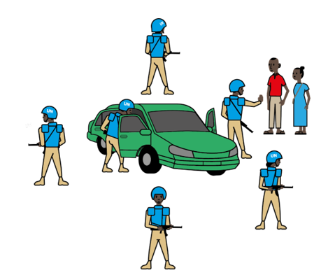
Vehicle Search
Basic Search – Vehicle
The search of a vehicle to detect vehicle-borne improvised explosive devices (VBIEDs), IED components, weapons, ammunition, or any other object that a perpetrator has attempted to conceal.
Notes:
The search of a vehicle to detect vehicle-borne improvised explosive devices (VBIEDs), IED components, weapons, ammunition, or any other object that a perpetrator has attempted to conceal. A vehicle search involves an initial check of persons and their vehicle, from which an assessment can be made as to whether any further search is required. Vehicle search within basic search involves initial checks and can involve primary searches.

Slide 55
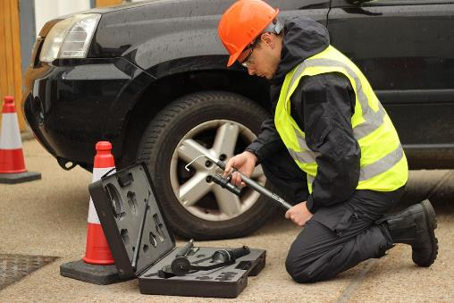
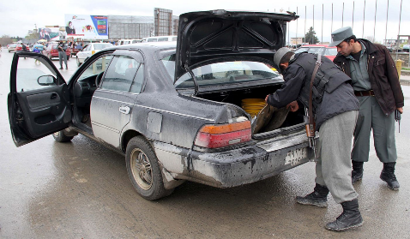
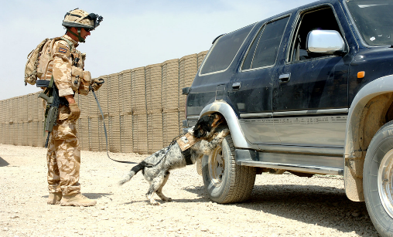
Vehicle Search
Levels of Vehicle Search
Secondary -
Conducted by specialist
Secondary search is only conducted by specially trained persons such as police investigators etc
Covered in EHAT
Primary
Initial
Increasing level of:
Threat
Time
Training
Rules/legal
Notes:
There are three levels of vehicle search. Initial, Primary and Secondary. An initial search is usually conducted at entry to venues or at checkpoints. This is a very quick search which does not require the occupants to get out the vehicle. It is done to screen other vehicles for further search and to deter potential threats. If after an initial search, suspicion is raised a primary search will normally take place. This will involve the occupants getting out the vehicle and also being searched. This usually takes about 10 minutes. If something is found or there is further suspicion a secondary search could be conducted, but this is done by a trained specialist – usually the police.
Image Left – Initial searches something involve the use of explosive detection dogs. Image courtesy UK MOD.
Image Centre – Afghan National Police conducting a primary search. This type of search is normally done in pairs. Image courtesy of UK MOD.
Image Right – Specialist conducting vehicle search. Image courtesy NIC Equipment.

Slide 56

Vehicle Search
Understanding Initial and Primary Search
This is just an example to explain the difference between Initial Check and Primary Search. This is not a lesson on Vehicle Check Points.
Commander
Person Search Pair
Car
Primary Search Pair
If suspicion aroused, primary search carried out
Car
Car
Car
Car
Traffic Control / Overwatch
Initial Check
If no further search is required, vehicle allowed to proceed.
Notes:
This slide shows an examples of a possible vehicle check point. In this example, we have:
A commander responsible for command and control.
Overwatch, Traffic Control. Traffic will initially be met by a Traffic Control point. This solder is responsible for holding traffic and looking out for early indications of threats in queueing traffic.
We then have two soldiers carrying out the Initial Check. If there is nothing suspicious, the vehicle is release to carry on its journey. If there is requirement for further search, the vehicle will be directed to the search area.
In the Search Area, two soldiers will carry out a Primary Search.
We also have 2 solders for conducting a person search.
In this scenario you can see that the initial check is a deterrence and screening process. The vehicles requiring further primary search are moved to another area to allow for minimum disruption to the civilian traffic.

Slide 57
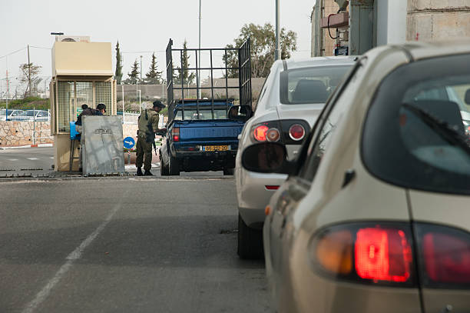
Vehicle Search
Initial Check
Normally a search pair will perform the checks
Normally requires about one minutes per vehicle
One searcher to question driver
One searcher checks the vehicle
Occupants generally remain in the vehicle
Notes:
An initial check is a very basic check. It is used as a deterrence and to help screen vehicles which require further searching. Generally it does not require occupants to get out the vehicle and can be conducted by 2 persons; 1 who questions the driver and occupants and the other who looks around the vehicle for anything that seems suspicious. This usually takes less than two minutes.
Image Courtsey Getty Images

Slide 58
Vehicle Search
Initial Check
Searcher 1
Speaks to the driver and occupants
Looking for suspicious behaviour (unusually polite or nervous occupants)
Confirm ID or driver and vehicle registration match (subject to mission rules)
Looking for missing keys
Strong smells
May ask the driver to turn off the engine
Searcher 2
Conducts a quick walk around the car
Looks for unusual modifications
Vehicle overloaded
May look inside the luggage compartment
May use mirrors to look under the vehicle
If Searchers are not satisfied, move to Primary Search
Notes:
The two searcher will have distinct roles. Searcher 1 will talk to the driver and occupants while searcher 2 carriers out a quick walk around the vehicle to look for indicators of potential IED threat, components, weapons etc.
The list shows some of the functions that each searcher should carry out and some of the indicators that might arouse suspicion. Remember, the vast majority of vehicle ocupants will be civilians trying to go about there normal lives, treat them with respect and always act within the rules of the mission.
Notes for the Instructor
Searcher 1
Speaks to the driver and occupants
Looking for suspicious behaviour (unusually polite or nervous occupants). People who have something to hide are often overly polite, this could raise suspicion. The same applies for nervous occupants.
Confirm ID or driver and vehicle registration match (subject to mission rules). Often vehicles conducting illegal activities use stollen vehicles.
Looking for missing keys. When a car is stolen it will often be missing its keys and needs to be start by other means.
Strong smells. The movement of chemical precursors or home made explosives often has strong chemical smell. This should raise suspicion.
May ask the driver to turn off the engine. Often components are hidden in empty batteries, if the car cannot be re-started after turning of the engine, this too could be grounds for a primary search.
Searcher 2
Conducts a quick walk around the car. This is general inspection for anything suspicious. The searcher should look through the windows to the interior of the vehicle.
Looks for unusual modifications. To hide components often modifications need to be made.
Vehicle overloaded. IED components can often be very heavy, signs of overloading but no obvious cargo could be an indicator of something being concealed.
May look inside the luggage compartment. The searcher may look in the luggage compartment to inspect cargo. (subject to mission rules)
May use mirrors to look under the vehicle. This is to look for anything hidden under the vehicle.

Slide 59

Vehicle Search
Primary Search
Carried out on vehicles that have been selected during the initial check
Search should be as detailed as time and conditions allow
Search must be systematic
Takes approximately 10 minutes
Ideally carried out by 4 pax. (2 searchers, a pair for searching occupants)
Notes:
If during the initial checks, a vehicle is highlighted for further searching due anything suspicious, a primary check will be carried out. A primary check may also be carried out where a higher degree of security is required and where there is a low number of vehicles than need checking. This check needs to be as detailed as the time or tactical situation will all and it must be done systematically by trained persons. This search can take up to 10 minutes and is usually carried out by a team of 4. 2 of whom will search the vehicle while the other pair are required to carry out a person search of the occupants or provide security.

Slide 60
Vehicle Search
Primary Search
Occupants and their baggage should be removed.
Occupants search separately by another pair, in view of their vehicle and possessions
Vehicle must be switched off.
All doors and compartments should be opened.

Slide 61
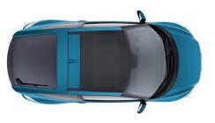
Vehicle Search
Primary Search
The search should be divided into three main areas:
Surrounding Area
Exterior Area
Interior Area
Notes:
A vehicle search can be conducted in many ways, but it must be systematic. One way of conducting a search is to divide into areas. Surrounding area, Exterior and Interior.

Slide 62
Vehicle Search
Primary Search
Surrounding Area
Items discarded by Occupants
Anything that has fallen off the vehicle or leaking from the vehicle
Notes:
The surrounding area should be verry briefly checked for any items that have been discarded by the occupants. This could be weapons, illegal contraband or documentation. Additionally anything that has leaked from the vehicle fallen off the vehicle should be investigated.

Slide 63
Vehicle Search
Primary Search
Exterior
Can be broken down into four areas:
Front
Side
Rear
Underside
Notes:
The exterior of the vehicle is broken down into four areas while doing a vehicle search.
Front, side, rear, underside.
The searcher should start with exterior, working as a pair moving in a sequential manner across all areas of the exterior. This can be done by splitting the vehicle in half with one searcher either side. The searcher should continuously be talking to each other to communicate what they can see.

Slide 64
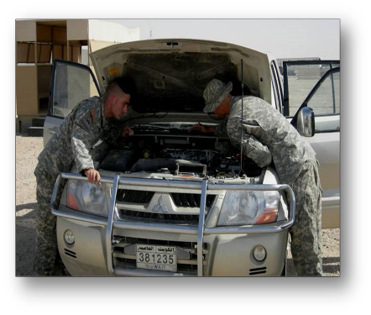
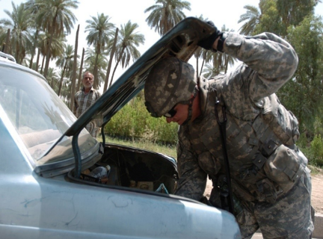
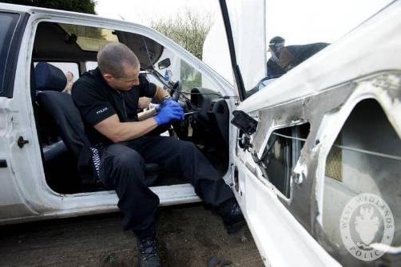
Vehicle Search
Primary Search
Interior:
Engine compartment
Boot / Trunk
Inside the vehicle
Storage compartments
Pannels
Under and in seats
Notes:
Once the exterior has been inspected, a thorough investigation of all internal compartments should be carried out. Again, this should be carried out in pars in a systematic way. This includes
Engine Compartment. Paying particular attention to arreas where items can be stored such as the air filter box or battery.
Boot Trunk. Both the compartment and spare wheel area should be checked. The spare when itself should also be check to see if items have need concealed inside.
Inside the vehicle. Both searchers should work from front to back as a pair. Particular attention should be paid to storage compartments, door panels, upholstery and the seats. The underside of the seats should be checked but the seat itself should be inspected to see if it has been altered to conceal items inside.
Image left to right
A police officer inspecting the interior of a vehicle – Courtesy UK West midlands Police.
A soldier inspecting the boot of a vehicle – Courtesy US DoD.
A pair of soldiers inspecting the engine compartment – Courtesy US DoD.

Slide 65

Vehicle Search
Primary Search
Considerations
Mission specific rules
Person search considerations apply
Sex
Technical knowledge
Notes:
Remember that mission rules will vary. No vehicle inspection should be carried out unless authorized. The considerations covered earlier regarding person search also apply. Remember that as occupants also need to be searched, consideration should be made for the searching of women and children. Finally, soldiers with some technical knowledge of how vehicle work will be helpful in carrying out vehicle search as they will be better placed for identifying anything out of place.

Slide 66
Vehicle Search
ACTIONS ON A FIND
Non Life Threatening Find:
Item removed
Search Completed
Subject Arrested
Life Threatening Find:
5Cs
Notes:
Non-Life Threatening Find:
Something which is or maybe evidence of a criminal offence / component part / suspicious documentation / unreasonable quantity of items (sim cards etc.)
The item is to be removed out of reach of the subject, while the search is completed.
At the end of the search, the subject may be asked for an explanation, if not satisfactory or suitable suspicion, FOR NON-LIFE THREATENING FINDS THE SEARCH MUST BE COMPLETED.
On completion of the search the subject is to be arrested.
Life threatening Find:
Confirm-Clear-Call-Cordon-Control

Slide 67
Vehicle Search
Primary Search
INSTRUCTOR DEMONSTRATION OF PRIMARY VEHICLE SEARCH
And
STUDENT PRACTICE
Notes:
Instructor to carry a full demonstration of a detailed person search.

Slide 68
2.2.4 Vulnerable Point Check

Slide 69
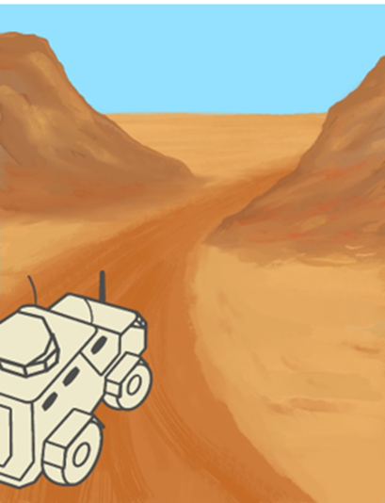
VP Check
A VP check is a basic search drill conducted in a low threat IED environment where a patrol or convoy does not have access to trained search team, but has no alternative than to pass through a VP.
No specific IED threat
Conducted with or without specialist equipment
Acts as a deterrence
Reduce probability and impact of IED strike
Notes:
A VP check is a basic search drill conducted in a low threat IED environment where a patrol or convoy does not have access to trained search team, but has no alternative that to pass through a VP. The drill is sometimes referred to as a VP 360 domination drill.
The drill is generally conducted in areas where there is no specific IED threat. If you are operating in a high threat IED environment, VPs must be searched by trained teams. Generally this drill is conducted without specialist equipment such as detectors, but if they are available they may be used. The main purpose of this drill is to act as a deterrence for IED emplacers/triggermen and to reduce the likelihood and impact of IED strikes.

Slide 70
VP Check
Why the need?
Allows a 360° check for Command wire/pull devices.
Allows a 360° view into the VP/VA.
Helps to identify possible firing points.
Enables troops to use GSA on the VP
Reduces the impact of an IED strike.
Places troops in a tactically favourable position:
Ground domination.
Fast and safe movement.
Protection.
Easy transition into a 5Cs.
Very hard to target.
Notes:
Why the need for VP Check?
The VP Check procedure allows for the following:
Locating and mitigation of Command wire/pull devices.
This will be done to negate the threat of any command wire/pull devices running into the VP via the sides or even running parallel with the route (linear features).
Allows a 360 view into the VP/VA.
Not just looking out for triggermen, also looking into VP from many different perspectives to increase the chance of being able to identify GSA or a threat from distance.
Identifying potential firing points.
Secure area with a cordon around the VP/VA.
Enables troops to use GSA on the VP
Troops inside a vehicles cannot employ GSA.
Reduces the impact of an IED strike.
The dismounting of troops and creating spaces between them mitigates the impact if there is an IED strike, particularly if travelling in soft skin or lightly armoured vehicles.
Tactically Favourable Position when entering a VP
Ground domination - Troops are deployed to protect the patrol/convoy. These forces can push any potential trigger men out of the area and protect against SALW attack.
Fast and safe movement – An effective, well practiced, team provides a safe and rapid negotiation of VP/VAs.
Protection (cordon) – the drill requires an effective cordon for the protection of patrols/convoys.
Easy transition into a 5Cs as troops are already securing the area, making a 5Cs operation much quicker and smoother.
Very hard to target - Distances are always varied making it very hard to target as patterns are not set and potential trigger men/scouts are flushed out of the area.

Slide 71
VP Check
Phases
Phase 1. Arrival: 5 and 25m Checks (ICP)
Phase 2. Domination
Phase 3. Isolation
Phase 4. Search Through
Notes:
VP 360 Domination Procedure Phases
1 – Arrivals and 5 and 25m checks
2 – Domination
3 – Isolation
4 – VP Search
We will now discuss these in more depth.

Slide 72
VP Check
Phase 1 – Arrival (5/25m Check)
Lead vehicle stops in an assessed safe location.
Distance from VP is not fixed but should be 75m-150m.
Top cover conducts all around 360 check.
5 and 25m checks conducted.
Notes:
Phase 1. Arrival 5 and 25m checks.
The VP 360 Domination Procedure can be executed by any different number of troops, as long as adequate protection is in place for the situation and ground.
At the selected ICP location 5 and 25m checks are conducted. Domination troops are also deployed at this stage. Once in position the Isolation parties can form up.

Slide 73

Phase 1. Arrival: 5 and 25m Checks
5 & 25m check
VP
75m – 150m
Notes:
Phase 1. Arrival: 5 and 25m checks
The slide shows the stop short location selection with the lead vehicle 75-150 metres from the assessed VP. Key here is to ensure that the site is not a previously used location to avoid setting patterns. Additionally the lead vehicle should be able to see the VP to enable command and control. Furthermore, the site selected should ideally be in a tactically favourable location and ensure that it is also not a VP. 5 and 25m checks conducted once the location is selected.

Slide 74
VP Check
Phase 2 – Domination
Utilise available troops to dominate the ground around the VP.
Deploy flanking patrols in vehicles or on foot to terrain which provides good overwatch and protection
Must remain a safe distance from the VP.
Must conduct 5 and 25m checks at over-watch positions.
Look for likely firing points, triggermen or scouts.
Don’t forget to also look out for adversary UAS.
All personnel must have weapons and ammunition.
Notes:
Phase 2. Domination
Available troops should be deployed to dominate the ground, high ground and lines of sight to the VP.
Depending on available manpower Flanking troops in vehicles or on foot can deploy to likely firing points for command IEDs. However, they must remain at a safe distance from the VP and conduct 5 and 25s at their overwatch position. Its important to remember that troops should not move to previously occupied positions to avoid setting patters. At the over watch positions, the domination troops should be looking for likely firing points and triggermen as well as adversary scouts which could be an indicator of a potential IED threat. Remember to also look out for the adversary using UAS which could also be an indicator. Additionally, as these troops are moving to these locations, there is a probability of encountering the aggressor and so they should be prepared for a tactical engagement. If terrain or thick vegetation does not allow domination of the VP, this should be achieved using the vehicle top gunner. Furthermore, if friendly UAS are available, they should also be used to support at this stage.

Slide 75

Phase 2. Domination
“5 and 25m checks”
VP
Notes:
Phase 2. Domination
The slide shows troops moving into position so as to dominate the ground. This will possibly deter/flush-out triggermen. 5 and 25m checks must be carried out when in position.

Slide 76
Questions?
Notes:
Are there any questions?
Pose questions to confirm the lesson stage since the last confirmation.

Slide 77
VP Check
Phase 3 – Isolation
The isolation looks for command wires and command pull devices running into the VP.
The TL is to assess which the threat side is deemed to be (most likely side for a command attack).
The TL must ensure the threat side is isolated first.
Team kit must be checked prior to the isolation.
Notes:
Phase 3. Isolation
The isolation is used to ensure there are no Command wire/pull devices running into the VP.
Composition of the team can vary. A five-person team is recommended, however, no fewer than two with armed escorts.
The team should have available:
Hook
Binoculars
Radio
A marking system such as pin markers

Slide 78
Phase 3. Isolation
Roles and responsibilities of isolation team members:
Pathfinder – Responsible for leading the isolation (under direction of the TL), visually searching.
Hook Person – Responsible for hooking all likely command wire/pull locations (linear features).
Team Leader – Responsible for controlling isolation party, they will have any available maps/imagery/sketches of the intended route. If a map is available, each turn is to be annotated for ease of communication with the convoy commander. They should have a radio but keep chat to a minimum and the radio is never to be used within 15m of CW or a linear feature.
Security – Responsible for force protection, if isolation party needs to reverse direction, the security escort and the Pathfinder, swap roles, to safely and efficiently return to the ICP.
Notes:
Phase 3. Isolation
Roles and responsibilities of isolation team members:
Pathfinder – responsible for leading the isolation along the TL’s pre-designated route while carrying out visual search
Hook Person – responsible for hooking linear features and likely command wire/pull locations
Team Leader – controls the isolation. Decides preferred route, maintains communications with ICP
Hook Person – responsible for hooking linear features and likely command wire/pull locations
Security – responsible for protection of the isolation party. If something is found, will swap roles with pathfinder on the team’s return to the ICP.

Slide 79

Phase 3. Isolation
Team Configuration
Pathfinder – Marking pins, weapon
Team Leader – Optical aids (e.g. binoculars), imagery, weapon
Hook Person – Hook, marking pins, weapon
Security – Marking pins, weapon
SECURITY
HOOK PERSON
TEAM LEADER
PATHFINDER
10m between each person
Direction of travel
Notes:
Phase 3 – Isolation
Team configuration
Explain each team member’s place within the team.
Pathfinder – Marking pins, weapon
Team Leader – Optical aids (e.g. binoculars), imagery, weapon
Hook Person – Hook, marking pins, weapon
Security – weapon

Slide 80
Phase 3. Isolation
Before any movement from the ICP a ground threat brief must be given to ensure isolation party are aware of the threat side and to think about their personal threat assessment.
The Isolation Team deploys from the rear of the searched area.
In single file they complete a 360 degree circuit of the VP.
10m spacing should be maintained. No less than 10m.
The route taken by the Isolation Team should be unpredictable.
Between 50m and 75m from the VP and roadside.
DO NOT SET PATTERNS, ALWAYS VARY THIS DISTANCE.
Notes:
Phase 3 – Isolation
The isolation party deploy to the rear of the halt point, move out to 50-75 metres and commence the search in single file maintaining a minimum of 10 metre spacing.
The route taken should be unpredictable, this will prevent pattern setting and targeting.
A distance of 50-75 metres is to be maintained from the VP during the 360 navigation of the VP.
An important task during the isolation is to identify potential firing points where triggermen could be.
Remembering the need for aiming markers.
If viable firing points are identified the party should maintain a safe distance from the likely contact point and relay information back to commander on the road. Who will direct domination teams to concentrate on that area.
Should anything be discovered it is to be marked, the Convoy commander informed and the team are to return to the safe area. 5Cs procedure will then be implemented.

Slide 81
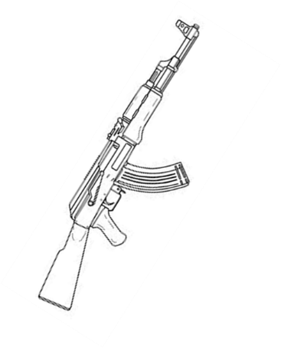
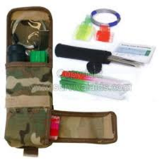
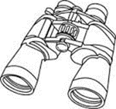
Isolation Team Equipment - Pathfinder
Viewing Aid
Marking and Extraction Kit
Personal Weapon
Notes:
Isolation Team Equipment – Pathfinder
What the Pathfinder will carry
Viewing aid, sufficient marker pins, weapon

Slide 82
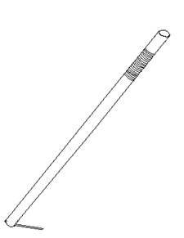
Isolation Team Equipment – Hook Person
Viewing Aid
Hook
Personal Weapon
Marking and Extraction Kit
Notes:
Isolation Team Equipment – Hook Person
Hook, viewing aid, sufficient marker pins, weapon

Slide 83
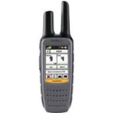
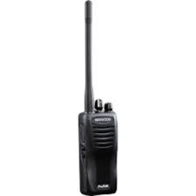
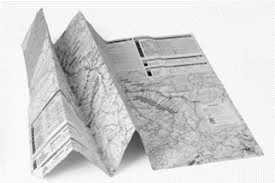
Isolation Team Equipment – Commander
GPS
Viewing Aid
Radio
Map/Air Photo
Personal Weapon
Marking and Extraction Kit
Notes:
Isolation Team Equipment – Team Leader
Radio, GPS, map/aerial photo, viewing aid, sufficient marker pins, weapon

Slide 84
Isolation Team Equipment - Security
Viewing Aid
Marking and Extraction Kit
Personal Weapon
Notes:
Isolation Team Equipment – Pathfinder
What the Pathfinder will carry
Viewing aid, sufficient marker pins, weapon

Slide 85
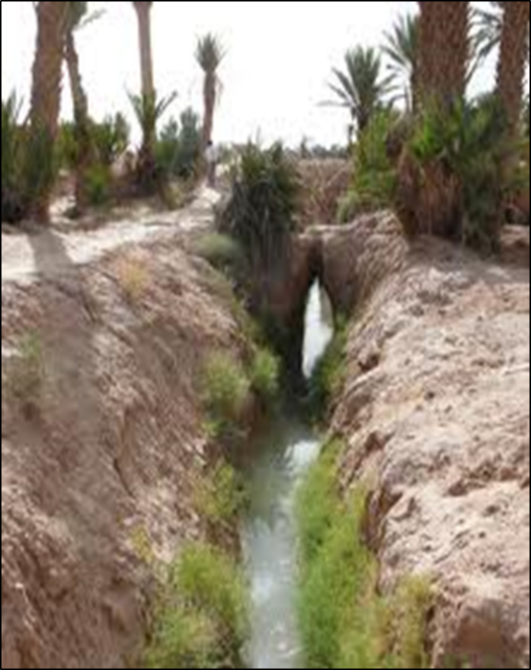
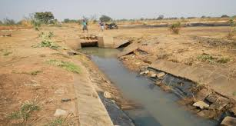
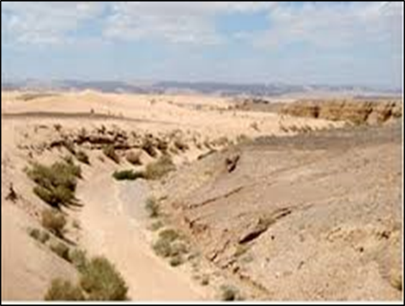
Linear Features
Linear features are used to conceal Command wires.
Observe the VP from a safe distance.
Report any information to the Commander
Notes:
Linear Features
These are the types of locations that the Hook Persons are to check for command wire/pull

Slide 86
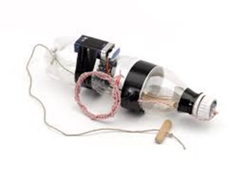
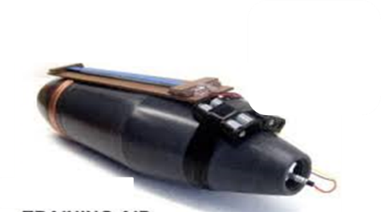
Actions on CW Find
Do not cut the Command Wire:
This could cause the device to function
Do not pull the Command Wire:
Could be Command Pull
Do not follow the Command Wire:
It is predictable
Notes:
Actions On CW Find
Do not cut the Command Wire:
This could cause the device to function
Do not pull the Command Wire:
Could be Command Pull
Do not follow the Command Wire:
It is predictable

Slide 87





Actions on CW Find
Confirm the CW
Mark position of CW
Extract 20m
Make an assessment of FP/CP
Inform Commander
Return to vehicle via safe route
EOD ICP - 5Cs Operation
Notes:
Actions On CW Find
Confirm the CW
Mark position of CW
Extract 20m
Make an assessment of FP/CP
Inform Commander
Return to vehicle via safe route
EOD ICP - 5Cs Operation

Slide 88
Phase 3. Isolation
50 – 75m
50 – 75m
VP
Notes:
Phase 3. Isolation
The slide shows the conduct of the isolation. The instructor should highlight that the route is rectangular for instructional purposes. It does not need to be rectangular and should take the most tactically favourable route, avoiding setting patterns and avoiding VPs on the isolation route. The isolation team will ensure they visually observe the VP from multiple angles to identify GSA, command wires or receivers this can be aided by the use of binoculars. They are also looking for Firing Points and triggermen. Linear features need to be “hooked” for command wires. The patrol needs to maintain an aggressive posture in case of ambush.

Slide 89
Questions?
Notes:
Are there any questions?
Pose questions to confirm the lesson stage since the last confirmation.

Slide 90
VP Check
Phase 4 – Search Through
If no threat of indication of IED found on isolation.
A dismounted patrol through the VP.
Conducted without equipment unless available.
Notes:
Phase 4. VP Search
If no threat or indication is found during isolation, the final phase is to conduct a search of the VP. In simple terms, this is a dismounted patrol through the VP using ground sign awareness to identify any potential IED. It is generally conducted without specialist equipment but if there are detectors available and there are trained persons, then they should be employed here.

Slide 91



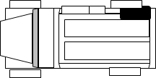



Configuration
Outer Rd Person 1
Inner Rd Person 2
Commander
10m Min
10m Min
10m Min
Inner Rd Person 1
10m Min
Outer Rd Person 2
Minimum 10m Between troops
Notes:
Phase 4 – Search Through
Configuration
Explain set up of VP Search Team.
Note the 10m distance between all personnel; this is to be maintained throughout.

Slide 92
Procedure
The team move forward conducting a search of the road surface and adjacent areas out to a distance in line with the threat.
A minimum of 10m should be maintained between troops.
If a vehicle is moving forward with the VP 360 team it should be directly behind the TL unless this would disrupt the search.
Areas of responsibility should overlap.
Notes:
Procedure
The VP 360 team move forward conducting a search of the road surface and adjacent areas out to a distance in line with the threat
A minimum of 10m should be maintained between troops
If a vehicle is moving forward with the VP 360 team it should be directly behind the TL unless this would disrupt the search
Areas of responsibility should overlap
A physical and visual search is conducted looking for GSA, IED Indicators (CAGE)
The overlap is ensured through the TC/TL.

Slide 93




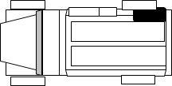


Areas of Responsibility
Notes:
Areas of Responsibility
ORP – Wide arcs of view out to the flanks and into the route. This includes looking not only forwards but also back down the route into the areas where the IRP will search (Different perspectives will often show ground sign more clearly).
IRP – Narrower arcs of view required but maintain a look out to the flanks and visuals down the route.
On the last animation (All search areas visible) highlight how extensively searched the area has been.

Slide 94
Phase 4. VP Search
TL lines team up in their lanes.
2m inside searched area.
Check overlap.
Confirm coverage.
VP
10m
Notes:
Phase 4. Search through
This slide shows the procedure of the VP search

Slide 95
Actions on Suspected IED
If a suspected IED is confirmed:
All except finder extract back to vehicle under direction of Commander.
Finder marks IED and safe extraction route.
VP 360 and vehicle extract to safe location.
EOD ICP - 5Cs Operation
Notes:
Actions on Suspected IED
If a suspected IED is confirmed:
All except finder extract back to vehicle under direction of Commander
Finder marks IED and safe extraction route
VP 360 and vehicle extract to safe location
5Cs operation commences

Slide 96
VP Check
INSTRUCTOR DEMONSTRATION OF VP CHECK
And
STUDENT PRACTICE
Notes:
Instructor to carry a full demonstration of a detailed person search.

Slide 97
2.2.5 Property Search

Slide 98
Property Search
New Course Content required
Notes:
Just like humans, EDD cannot work indefinitely. They need to be used for a limited specific time periods before being rested. This time will depend on the environmental conditions such as the temperature. It is also worth noting that EDD rely on their sense of smell. Factors such as strong wind and rain will severely affect the dogs ability to identify a target.

Slide 99
Questions?

